Slide 1
AZ-220T01 Module 8: Device management

Slide 2
Lesson 1: Learning objectives

Slide 3
Module 8 – Learning objectives
Describe the most common device management patterns and configuration best practices
Describe when and how to use device twins and direct methods to implement device management
Implement device management for various patterns using device twins and direct methods
Implement device management at scale using automatic device management and jobs

Slide 4

Lesson 2: Introduction to IoT device management

Slide 5
What is device management?
Device management principles:
Scale & Automation
Openness & Compatibility
Context Awareness
Service Many Roles
Notes:
Scale and automation: IoT solutions require simple tools that can automate routine tasks and enable a relatively small operations staff to manage millions of devices. Day-to-day, operators expect to handle device operations remotely, in bulk, and to only be alerted when issues arise that require their direct attention.
Openness and compatibility: The device ecosystem is extraordinarily diverse. Management tools must be tailored to accommodate a multitude of device classes, platforms, and protocols. Operators must be able to support many types of devices, from the most constrained embedded single-process chips, to powerful and fully functional computers.
Context awareness: IoT environments are dynamic and ever-changing. Service reliability is paramount. Device management operations must take into account the following factors to ensure that maintenance downtime doesn't affect critical business operations or create dangerous conditions:
SLA maintenance windows
Network and power states
In-use conditions
Device geolocation
Service many roles: Support for the unique workflows and processes of IoT operations roles is crucial. The operations staff must work harmoniously with the given constraints of internal IT departments. They must also find sustainable ways to surface realtime device operations information to supervisors and other business managerial roles.

Slide 6
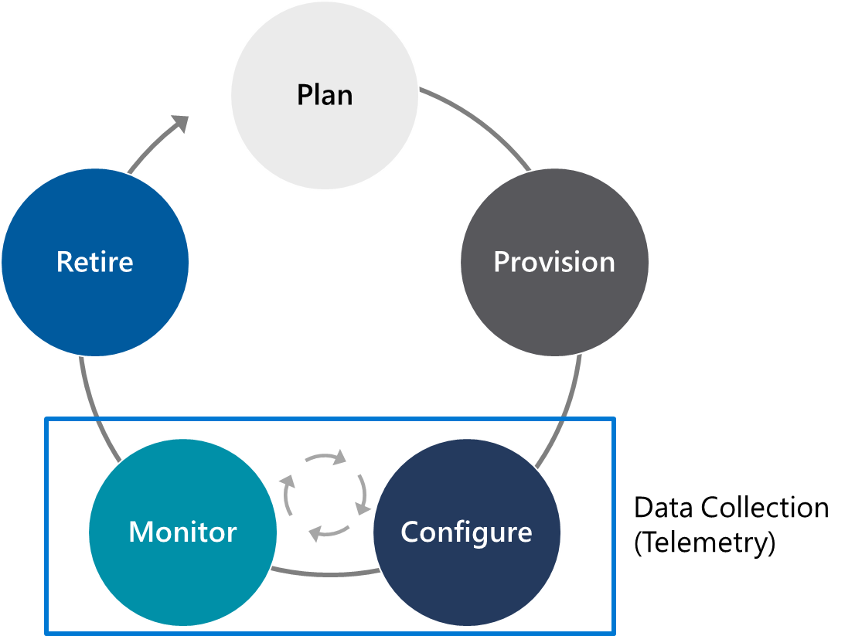
What is device management?
Device Lifecycle
Notes:
This is 100% a duplicate slide from before, except we have changed the title. We are looping back around to this lifecycle because device management is part of making the lifecycle “real” and impacts the implementation of each of the five phases of the lifecycle.
We’re going to also add automation to some of what we have done manually to this point.

Slide 7
Device management patterns
Reboot
Physical Device
Back-end application
Factory reset
Method handler
Method Request
Invoke reboot Method
Method Response
2
1
Device twin
Configuration
Properties. Reported
Report last reboot time
Update
Data
Firmware update
3
Query
Get twin or query
Reboot and reconnect
4
Reporting progress and status
4
Notes:
“Some typical device management tasks an operator might perform include…”
A reboot is often a direct method invocation. We haven’t explained that yet, so mention that we will explain what is going on there in a bit.

Slide 8
Device management patterns
Reboot
Physical Device
Back-end application
Factory reset
Method handler
Method Request
Invoke factory reset method
Method Response
2
1
Device twin
Configuration
Properties. Reported
Report last factory reset time
Update
Data
Firmware update
3
Query
Get twin or query
Factory reset and reconnect
4
Reporting progress and status
4
Notes:
A factory reset is often a direct method invocation.

Slide 9
Device management patterns
Reboot
Physical Device
Device twin
Back-end application
Properties. Desired
Factory reset
Desired changed event handler
Update desired configuration
Data
2
1
Configuration
Apply configuration
3
Firmware update
Properties. Reported
Report configuration
Update
Data
Query
Get twin or query
Reporting progress and status
4
4
Notes:
Configuration changes are normally done through a device twin.

Slide 10
Device management patterns
Reboot
Device
Cloud
Device app
IoT hub
Back-end app
Factory reset
Device twin
Automatic device management
Firmware desired property update handler
Desired properties
Firmware update configuration
Configuration
Set
Create
Receive desired property updates
Start
Firmware update
Firmware update process:
Download image
Verify image
Apply image
Reboot device
Reported properties
Report status through reported properties
Monitor Status
Query
Reporting progress and status
Notes:
Firmware updates are typically handled through an automatic device configuration process, as we’ll discuss later.
One thing to think about as part of this is that if there’s any interest in firmware updates, although we don’t discuss that process (again, not a device firmware engineer class), you could mention that Azure CDN offers a way to do large-scale caching of firmware files, which can help with deployment of firmware updates.

Slide 11
Device management patterns
Reboot
Physical Device
Set of device twins
Back-end application
Device twin (dt₀)
Factory reset
Properties. Reported
Query
Run query against set of twins
Report Status (t₀)
Update
Data
1
2
Configuration
Report Status (t₁)
Update
Data
3
Report Status (t₂)
Update
Data
Run query against set of twins
Firmware update
Query
4
5
Device twin (dt₁)
Reporting progress and status
Device twin (dt_{n})
Notes:
Reporting progress and status is often done through device twins.

Slide 12
Device configuration with device twins
Device
Cloud
IoT hub
Device twin
Device twin
Back-end app
Device app
Desired properties
Desired properties
Read
Set
Set
Reported properties
Reported properties
Read
Tags
Set and Read
Notes:
(this is slide 1 of 6 in a series that details device configuration)
“You may notice three of the five device patterns were built on top of device twins. Let’s look a little more at the device twin configuration process…”
Device Twins were introduced way back in Module 2 at a high level.
The maximums that relate to the document sections are:
Desired and reported sections can be 32 KB each
Tags can be 8 KB
Each property key can be up to 1 KB with a value up to 4 KB
(https://azure.microsoft.com/en-us/updates/iot-hub-new-features-now-available-for-device-and-module-twins/)
This might be a good time to drop the surprise that only MQTT (including over WebSockets) and AMQP (including over WebSockets) can do device twins; pure HTTPS does not support them.

Slide 13
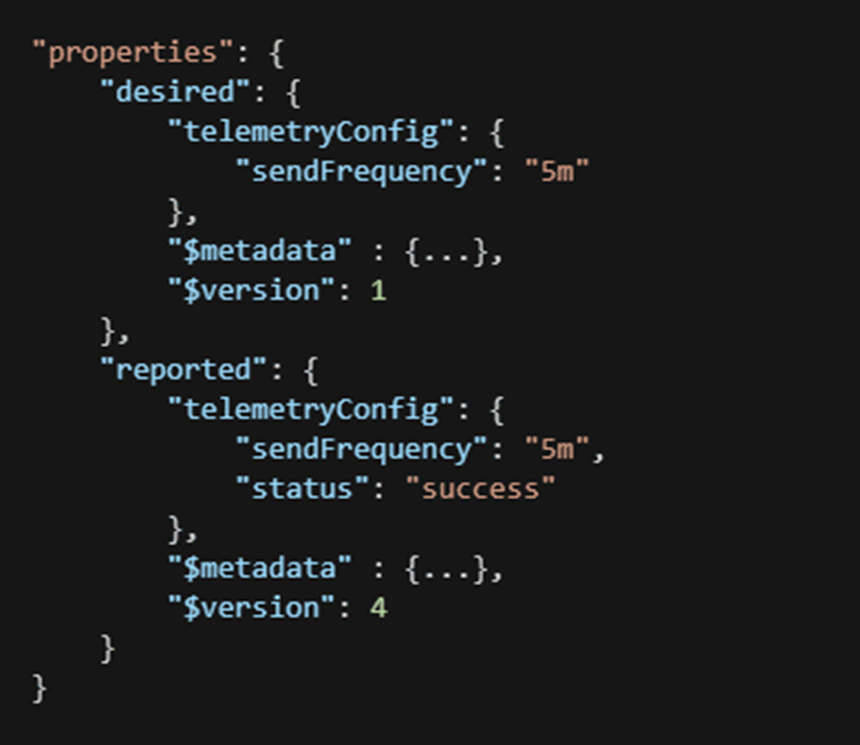
Device configuration with device twins
Device twin properties
Back-end operations
Device operations
Device twin metadata
Optimistic concurrency
Device reconnection flow
Notes:
“Device twins, which you briefly looked at in labs earlier in the course, you may recall are JSON documents that have a specific set of properties, both desired, meaning what you are asking the device to set, and reported, which is what the device says it has configured. They also include a version number and some miscellaneous metadata, such a timestamps.”

Slide 14
Device configuration with device twins
Device twin properties
Back-end operations
Device operations
Device twin metadata
Optimistic concurrency
Device reconnection flow
Notes:
“Until now, when working with changing properties in device twins, you have been doing that through manual edits in the portal. However, in real life, that is not scalable. Device operators will instead use device management applications – or ‘back-end applications’ – to manage their device configurations. These work through back-end operations exposed by the IoT Hub to allow a back-end application to change the device twin properties.

Slide 15
Device configuration with device twins
Device twin properties
Back-end operations
Device operations
Device twin metadata
Optimistic concurrency
Device reconnection flow
Notes:
“Besides requesting changes to device twins, you can also request information on device twins, for reporting or logging purposes, for example. This falls into the category of ‘device operations.’ This can include a direct request for twin information, or registration of a change handler, to be informed of changes.”

Slide 16
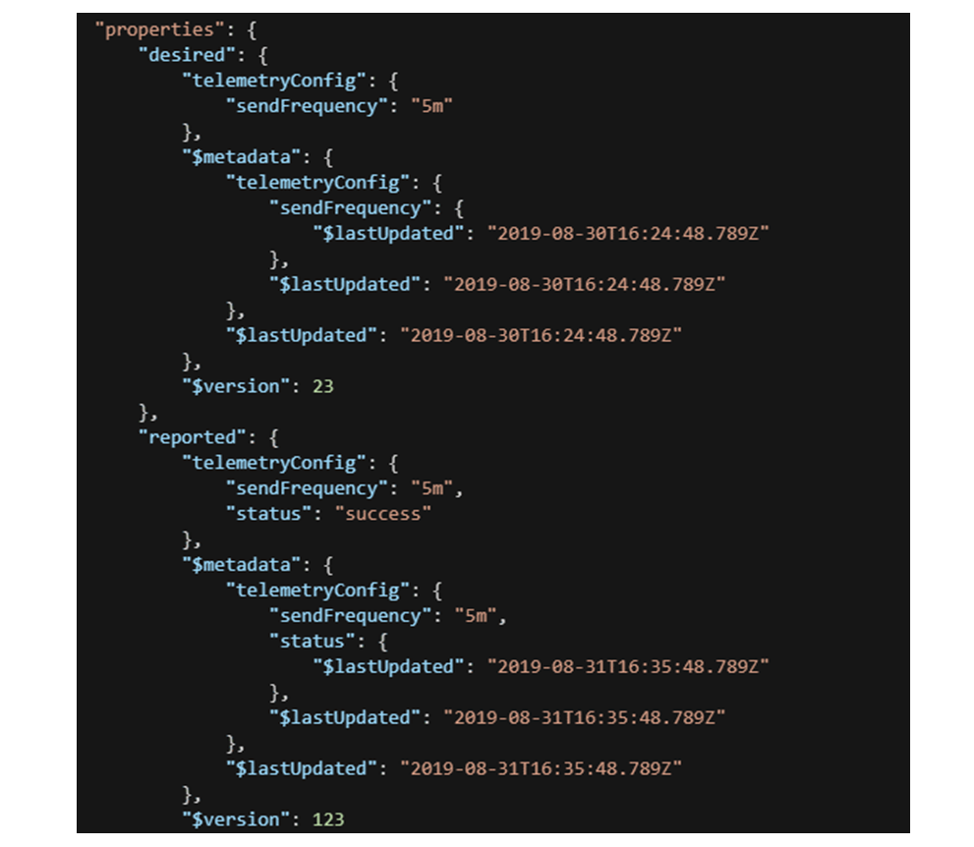
Device configuration with device twins
Device twin properties
Back-end operations
Device operations
Device twin metadata
Optimistic concurrency
Device reconnection flow
Notes:
“As previously mentioned, device twins also have metadata associated with them. The metadata field explicitly carries update timestamps, while there is also a version field, which is itself a form of metadata.”

Slide 17
Device configuration with device twins
Device twin properties
Back-end operations
Device operations
Device twin metadata
Optimistic concurrency
Device reconnection flow
Notes:
For these last two, the recommendation is to not deep dive on them but leave it as “an exercise for the reader.” Just be sure to explain the concept of optimistic concurrency, and that IoT Hub does not “remember” if a device has received updated device twin information, so even when a device has subscribed to update notifications for specific twin properties, it must always retrieve the full set of properties in the notification event handler. (This also avoids any possibility of race conditions around delivery of notifications vs. concurrent changes to the twin configuration.)

Slide 18
Direct methods: Introduction
Direct methods – requests from the cloud to a device, executing code directly on the target
Features:
Each call targets a single device or module instance
Can be used by anyone with appropriate IoT Hub permissions
Follow a request-response pattern for immediate feedback
Lifecycle:
Called by a back-end application through an HTTPS URL pattern on the IoT Hub
Translated to MQTT or AMQP on the device side
Reply received from the device sent directly back to the back-end application
Notes:
“Earlier, direct methods were mentioned for things like factory reset and device reboot, but we didn’t really explain what that meant.”
Mention that direct methods exist on modules in IoT Edge as well, but we’re focusing on the device view here.

Slide 19
Direct methods: Sample back-end service call
curl -X POST \
https://iothubname.azure-devices.net/twins/myfirstdevice/methods?api-version=2018-06-30 \
-H 'Authorization: SharedAccessSignature sr=iothubname.azure-devices.net&sig=x&se=x&skn=iothubowner’ \
-H 'Content-Type: application/json’ \
-d ‘{
"methodName": "reboot",
"responseTimeoutInSeconds": 200,
"payload": {
"input1": "someInput",
"input2": "anotherInput"
}
}'

Slide 20
Direct methods: Return value to the back-end
HTTP Status Code
Standard HTTP headers:
Etag
Request ID
Content type
Content encoding
JSON Body
{ “status” : 201, “payload” : { … } }

Slide 21
Direct methods: Device-side view
IoT Hub posts to MQTT topic: $iothub/methods/POST/{method name}/?$rid={request id}
Device posts response to $iothub/methods/res/{status}/?$rid={request id}
Handle a direct method on a device: MQTT
Handle a direct method on a device: AMQP
Device creates a receive link for IoT Hub to use against the IoT Hub at amqps://{hostname}:5671/devices/{deviceId}/methods/deviceBound
Device creates a send link against IoT Hub at the same endpoint

Slide 22
Comparing device management approaches
 | Direct Method Call | Device Twins | Cloud-to-Device Messages
Scenario | Requires immediate confirmation | Long-running desired state configuration | One-way notifications
Data flow | Two-way with immediate response | One-way. The device app receives a notification with the property change | One-way. The device app receives the message
Durability | Disconnected devices are not contacted. The solution back end is notified that the device is not connected | Property values are preserved in the device twin. Device will read it at next reconnection. Property values are retrievable with the IoT Hub query language | Messages can be retained by IoT Hub for up to 48 hours
Targets | Single device using deviceId, or multiple devices using jobs. | Single device using deviceId, or multiple devices using jobs | Single device by deviceId
Size | Payload maximum is 128 KB | Desired properties maximum is 32 KB | Up to 64 KB messages
Frequency | High | Medium | Low
Protocol | MQTT or AMQP | MQTT or AMQP | MQTT, AMQP, HTTPS
Notes:
Source: https://docs.microsoft.com/en-us/azure/iot-hub/iot-hub-devguide-c2d-guidance

Slide 23

Lesson 3: Manage IoT and IoT Edge devices

Slide 24
Device management tools
IoT Hub (Azure portal)
Azure CLI
Visual Studio Code
SDKs

Slide 25
Device management using the IoT extension for Azure CLI
Direct Methods
Device twin desired properties
Device twin reported properties
Device twin tags
Device twin queries

Slide 26
Device management using the Azure IoT tools for VS Code
Access Your IoT Hub and Devices
Access Device Management Commands

Slide 27
Lesson 4: Device management at scale

Slide 28
Schedule jobs on multiple devices: Concepts
IoT Hub jobs – allow calling direct methods or setting device twin properties across a large number of devices
Job lifecycle:
Call service URL to create the job
Call different URL to query on the status of the job
Notes:
We don’t use this in the labs, so don’t feel the need to super very deep on this. Instead, just mention the high-level concepts, and move on. The SkillPipe has details.
One important note is that for setting device twin properties, we have a replacement on the next slide, but for group direct method invocation, there’s not an alternative in the product at this time.

Slide 29
Schedule jobs: Direct methods example
PUT /jobs/v2/<jobId>?api-version=2018-06-30
Authorization: <config.sharedAcessSignature>
Content-Type: application/json;ccharset=utf-8
{
“jobId”: “<jobId>”,
“type”: “scheduleDeviceMethod”,
“cloudToDeviceMethod”:
{
“methodName”: “<methodName>”,
“payload”: <payload>,
“respondTimeoutInSeconds”: methosTimeoutSeconds
},
“queryCondition”: “<queryOrDevice>”, //query condition
“startTime”: <jobStartTime>, //as an Iso-8601 date string
“maxecutionTimeInSeconds”: <maxecutionTimeInSecond>
}
Notes:
If questions arise in class as to why the term “device method” is used in the code, you can let students know that this is a legacy term and that “device method” and “direct method” are synonimous.

Slide 30
Automatic device management: Introduction
Automatic device management – bulk assignment of device twin data (and thus device configuration)
Requires the Standard tier
Reports the status of the deployment including possible custom metrics by queries against device twin reported properties
Can be done with the Portal, the CLI, or the IoT Hub Service SDK
Identify target devices using a tag query
Runs soon after creation, then every five minutes afterwards to handle changes in the target device list
Ordered priority of configurations
Notes:
“I gave you an example of a job with device method calls, but not with device twin properties. That’s because there is a replacement tool, Automatic Device Management…”
This will be in the labs, so don’t feel the need to deep dive on this necessarily. You should explain each of the bullets, however. Note that the SkillPipe doesn’t describe how to do this in the SDK, primarily because the documentation is weak on this right now.

Slide 31
Automatic device management: Modifications
Device comes into the target list: Appropriate highest-priority configuration is applied
Device leaves the target list:
If a lower priority match exists: Configuration values are removed and next appropriate priority configuration is applied
If a lower priority match does not exist: Configuration values are removed, no other changes
Configuration is deleted: No longer applies, but values are not removed
Notes:
This could be white-boarded as a flow chart if students need a more visual representation.

Slide 32
Device configuration best practices
Implement device twins
Organize devices using device twin tags
Implement automatic device configurations
Use the Device Provisioning Service
Notes:
Note that the SkillPipe covers roles besides IoT Developer, because there is a lot of overlap, but for the purposes of delivery, this is a Developer course, so we’re only presenting that role’s version of this information.

Slide 33
Lesson 5: Module labs

Slide 34
Module 8 labs
Lab 15: Remotely monitor and control devices with Azure IoT hub
You will create a back-end service app to listen for the telemetry
You will implement a direct method, to communicate settings to the IoT device
You will implement device twins functionality, to manage IoT device properties
Lab 16: Automate IoT device management with Azure IoT hub
You will write code for a simulated device that will implement a firmware update
You will test the firmware update process on a single device using Azure IoT Hub automatic device management

Slide 35
Lesson 6: Module 8 review questions

Slide 36
Module review: Question 8.1
You are developing an IoT solution for your company. You have IoT devices and IoT Edge devices configured and running in your solution. Data analysis has been completed using archived data, and this analysis revealed data trends and device behaviors that require your attention. You determine that implementing device management techniques will help to address the situation
What are the two primary approaches to device management? (choose all correct answers)
Answer A:
Machine learning
Answer B:
Direct methods
Answer C:
Device twins
Answer D:
Azure functions
Notes:
Correct Answer: B, C
Explanation: In the student workbook/skillpipe content, topic Device Management Patterns includes the following:
Back-end apps can use Azure IoT Hub primitives, such as device twins and direct methods, to remotely start and monitor device management actions on devices.
You can use a direct method to initiate device management actions (such as reboot, factory reset, and firmware update) from a back-end app in the cloud. The device is responsible for:
- Handling the method request sent from IoT Hub.
- Initiating the corresponding device-specific action on the device.
- Providing status updates through reported properties to IoT Hub.
You can use a back-end app in the cloud to run device twin queries to set a device twin desired property or to report on the progress of your device management actions. The device is responsible for:
- Handling the property changed event and updating the local variables that correspond to the device twin desired property.
- Communicating the device twin reported property setting to IoT hub after the updated desired property has been implemented successfully.

Slide 37
Module review: Question 8.2
You are developing an IoT solution for your company. You have IoT devices and IoT Edge devices configured and running in your solution. Data analysis has been completed using archived data, and this analysis revealed data trends and device behaviors that require your attention. You determine that implementing device management techniques will help to address the situation
Direct methods are recommended for which of the following device management patterns (choose all correct answers)
Answer A:
Reboot
Answer B:
Factory Reset
Answer C:
Configuration
Answer D:
Firmware update
Answer E:
Reporting progress and status
Notes:
Correct Answer: A, B
Explanation: In the student workbook/skillpipe content, topic Device Management Patterns includes the following:
Reboot: The back-end app informs the device through a direct method that it has initiated a reboot. The device uses the reported properties to update the reboot status of the device.
Factory Reset: The back-end app informs the device through a direct method that it has initiated a factory reset. The device uses the reported properties to update the factory reset status of the device.
Configuration: The back-end app uses the desired properties to configure software running on the device. The device uses the reported properties to update configuration status of the device.
Firmware Update: The back-end app uses an automatic device management configuration to select the devices to receive the update, to tell the devices where to find the update, and to monitor the update process. The device initiates a multistep process to download, verify, and apply the firmware image, and then reboot the device before reconnecting to the IoT Hub service. Throughout the multistep process, the device uses the reported properties to update the progress and status of the device.
Reporting Progress and Status: The solution back end runs device twin queries, across a set of devices, to report on the status and progress of actions running on the devices.

Slide 38
Module review: Question 8.3
You are developing an IoT solution for your company. You have IoT devices and IoT Edge devices configured and running in your solution. Data analysis has been completed using archived data, and this analysis revealed data trends and device behaviors that require your attention. You determine that implementing device management techniques will help to address the situation
Which of the following statements about device twins are true? (choose all correct answers)
Answer A:
The device twin desired and reported properties are used to synchronize device configuration
Answer B:
The solution back end sets the desired property with the desired configuration value
Answer C:
The device app reports the desired property to the solution back end
Answer D:
The solution back end can track the results of the configuration operation across many devices by querying device twins
Notes:
Correct Answer: A, B, D
Explanation: In the student workbook/skillpipe content, topic Device Management Patterns includes the following:
Consider the following "properties" section of a device twin document:
"properties": {
"desired": {
"telemetryConfig": {
"sendFrequency": "5m" },
"$metadata" : {...},
"$version": 1 },
"reported": {
"telemetryConfig": {
"sendFrequency": "5m",
"status": "success"
},
"$metadata" : {...},
"$version": 4 }
}
In this example, the telemetryConfig device twin desired and reported properties are used by the solution back end and the device app to synchronize the telemetry configuration for this device. An update to the device configuration could be implemented as follows:
- The solution back end sets the desired property with the desired configuration value.
- The device app is notified of the change immediately if connected, or at the first reconnect. The device app then reports the updated configuration (or an error condition using the status property).
- The solution back end can track the results of the configuration operation across many devices by querying device twins.

Slide 39
Module review: Question 8.4
You are developing an IoT solution for your company. You have IoT devices and IoT Edge devices configured and running in your solution. Data analysis has been completed using archived data, and this analysis revealed data trends and device behaviors that require your attention. You determine that implementing device management techniques will help to address the situation
Under what circumstances should you consider using IoT Hub Jobs to help with device management? (choose all correct answers)
Answer A:
When you need to schedule and track progress of desired property updates for devices
Answer B:
When you need to schedule and track progress of deprovisioning for devices
Answer C:
When you need to schedule and track progress of tag updates for devices
Answer D:
When you need to schedule and track progress of a direct method for devices
Notes:
Correct Answer: A, C, D
Explanation: In the student workbook/skillpipe content, topic Schedule Jobs on Multiple Devices includes the following:
Typically, back-end apps enable device administrators and operators to update and interact with IoT devices in bulk and at a scheduled time. Jobs execute device twin updates and direct methods against a set of devices at a scheduled time. For example, an operator would use a back-end app that initiates and tracks a job to reboot a set of devices in building 43 and floor 3 at a time that would not be disruptive to the operations of the building.
Consider using jobs when you need to schedule and track progress any of the following activities on a set of devices:
- Update desired properties
- Update tags
- Invoke direct methods

Slide 40
Module review: Question 8.5
You are developing an IoT solution for your company. You have IoT devices and IoT Edge devices configured and running in your solution. Data analysis has been completed using archived data, and this analysis revealed data trends and device behaviors that require your attention. You determine that implementing device management techniques will help to address the situation
Which of the following statements about automatic device management are correct? (choose all correct answers)
Answer A:
Automatic device management requires the Standard tier of the IoT Hub service
Answer B:
Automatic device management uses a JSON document called a Configuration
Answer C:
Automatic device management uses a JSON document called a Manifest
Answer D:
Automatic device management works with any tier of the IoT Hub service
Notes:
Correct Answer: A, B
Explanation: In the student workbook/skillpipe content, topic Automatic Device Management using Azure Portal includes the following:
Automatic device management in Azure IoT Hub automates many of the repetitive and complex tasks of managing large device fleets. With automatic device management, you can target a set of devices based on their properties, define a desired configuration, and then let IoT Hub update the devices when they come into scope. This update is done using an automatic device configuration, which lets you summarize completion and compliance, handle merging and conflicts, and roll out configurations in a phased approach.
Note: Automatic device management requires the Standard tier of the IoT Hub service.
Automatic device management works by updating a set of device twins with desired properties and reporting a summary that's based on device twin reported properties. It introduces a new class and JSON document called a Configuration that has three parts:
- The target condition defines the scope of device twins to be updated. The target condition is specified as a query on device twin tags and/or reported properties.
- The target content defines the desired properties to be added or updated in the targeted device twins. The content includes a path to the section of desired properties to be changed.
- The metrics define the summary counts of various configuration states such as Success, In Progress, and Error. Custom metrics are specified as queries on device twin reported properties. System metrics are the default metrics that measure twin update status, such as the number of device twins that are targeted and the number of twins that have been successfully updated.

